Slide 1
Political Reporting Tools
Sean McMinn, Kate Ackley and Ryan Kelly
Github.com/shmcminn/cqrc-campfin

Slide 2
Agenda
FEC data
Bundlers and lobbyists
CQ’s vote data

Slide 3
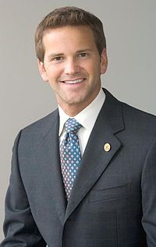
Campaign Finance and (Alleged) Crooks
Recognize this guy?

Slide 4
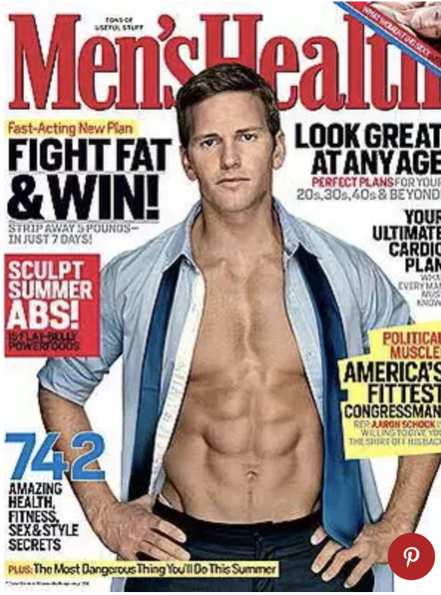
Campaign Finance and (Alleged) Crooks
Does this help?

Slide 5
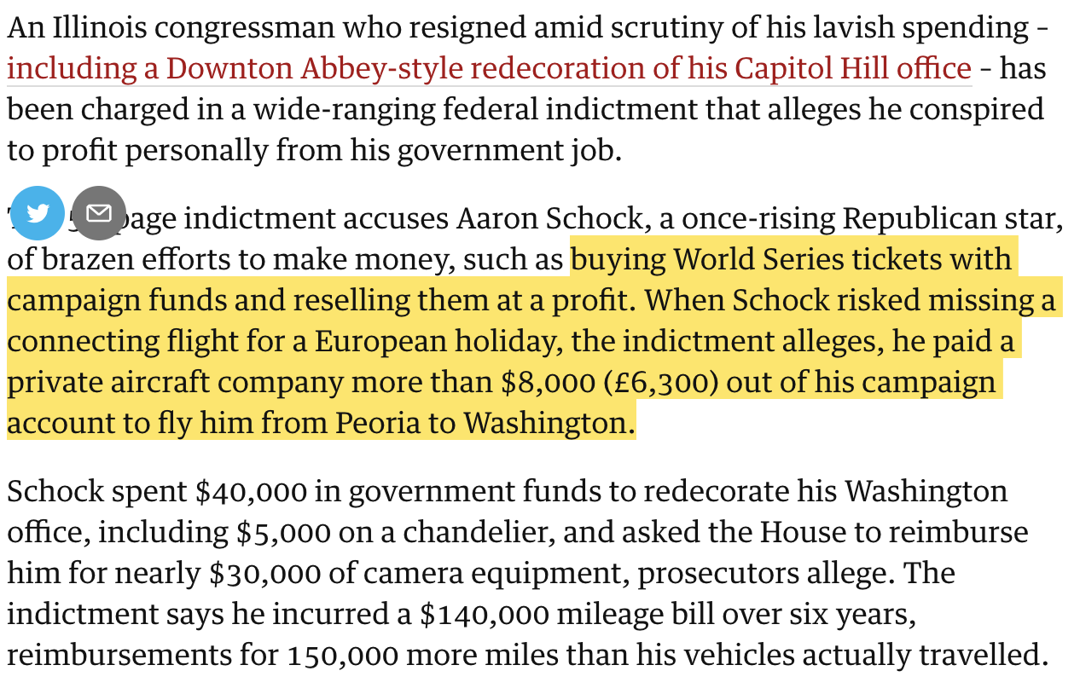
Campaign Finance and (Alleged) Crooks
Notes:
This was at the end of 2016 … Trial set for next January

Slide 6
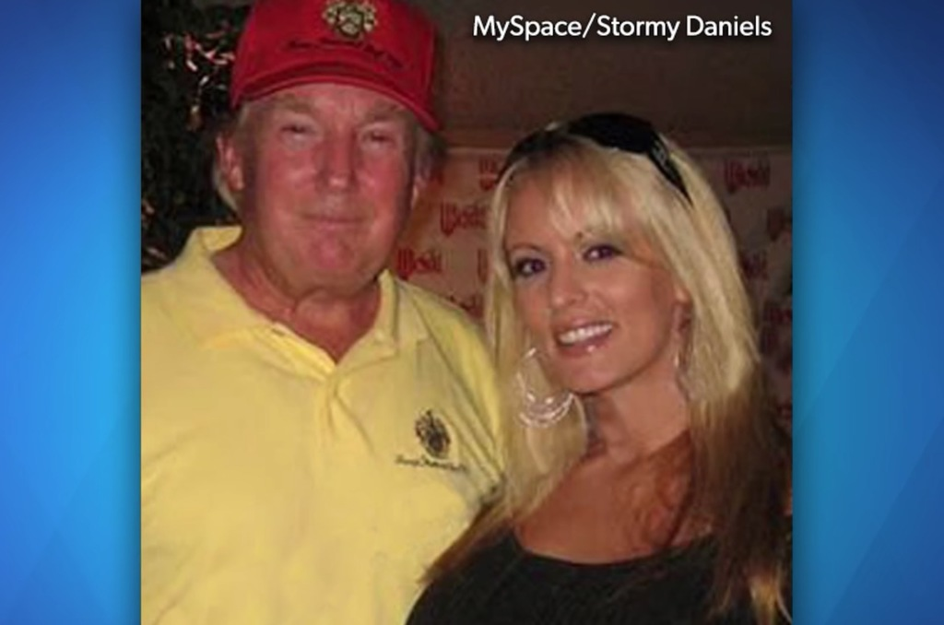
Campaign Finance and (Alleged) Crooks
Recognize this pair?

Slide 7
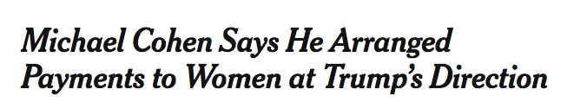
Campaign Finance and (Alleged) Crooks

Slide 8
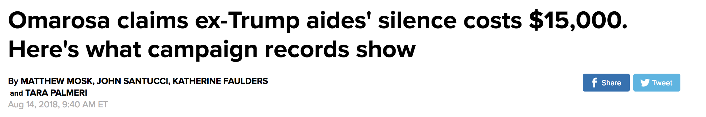


Campaign Finance and (Alleged) Crooks

Slide 9
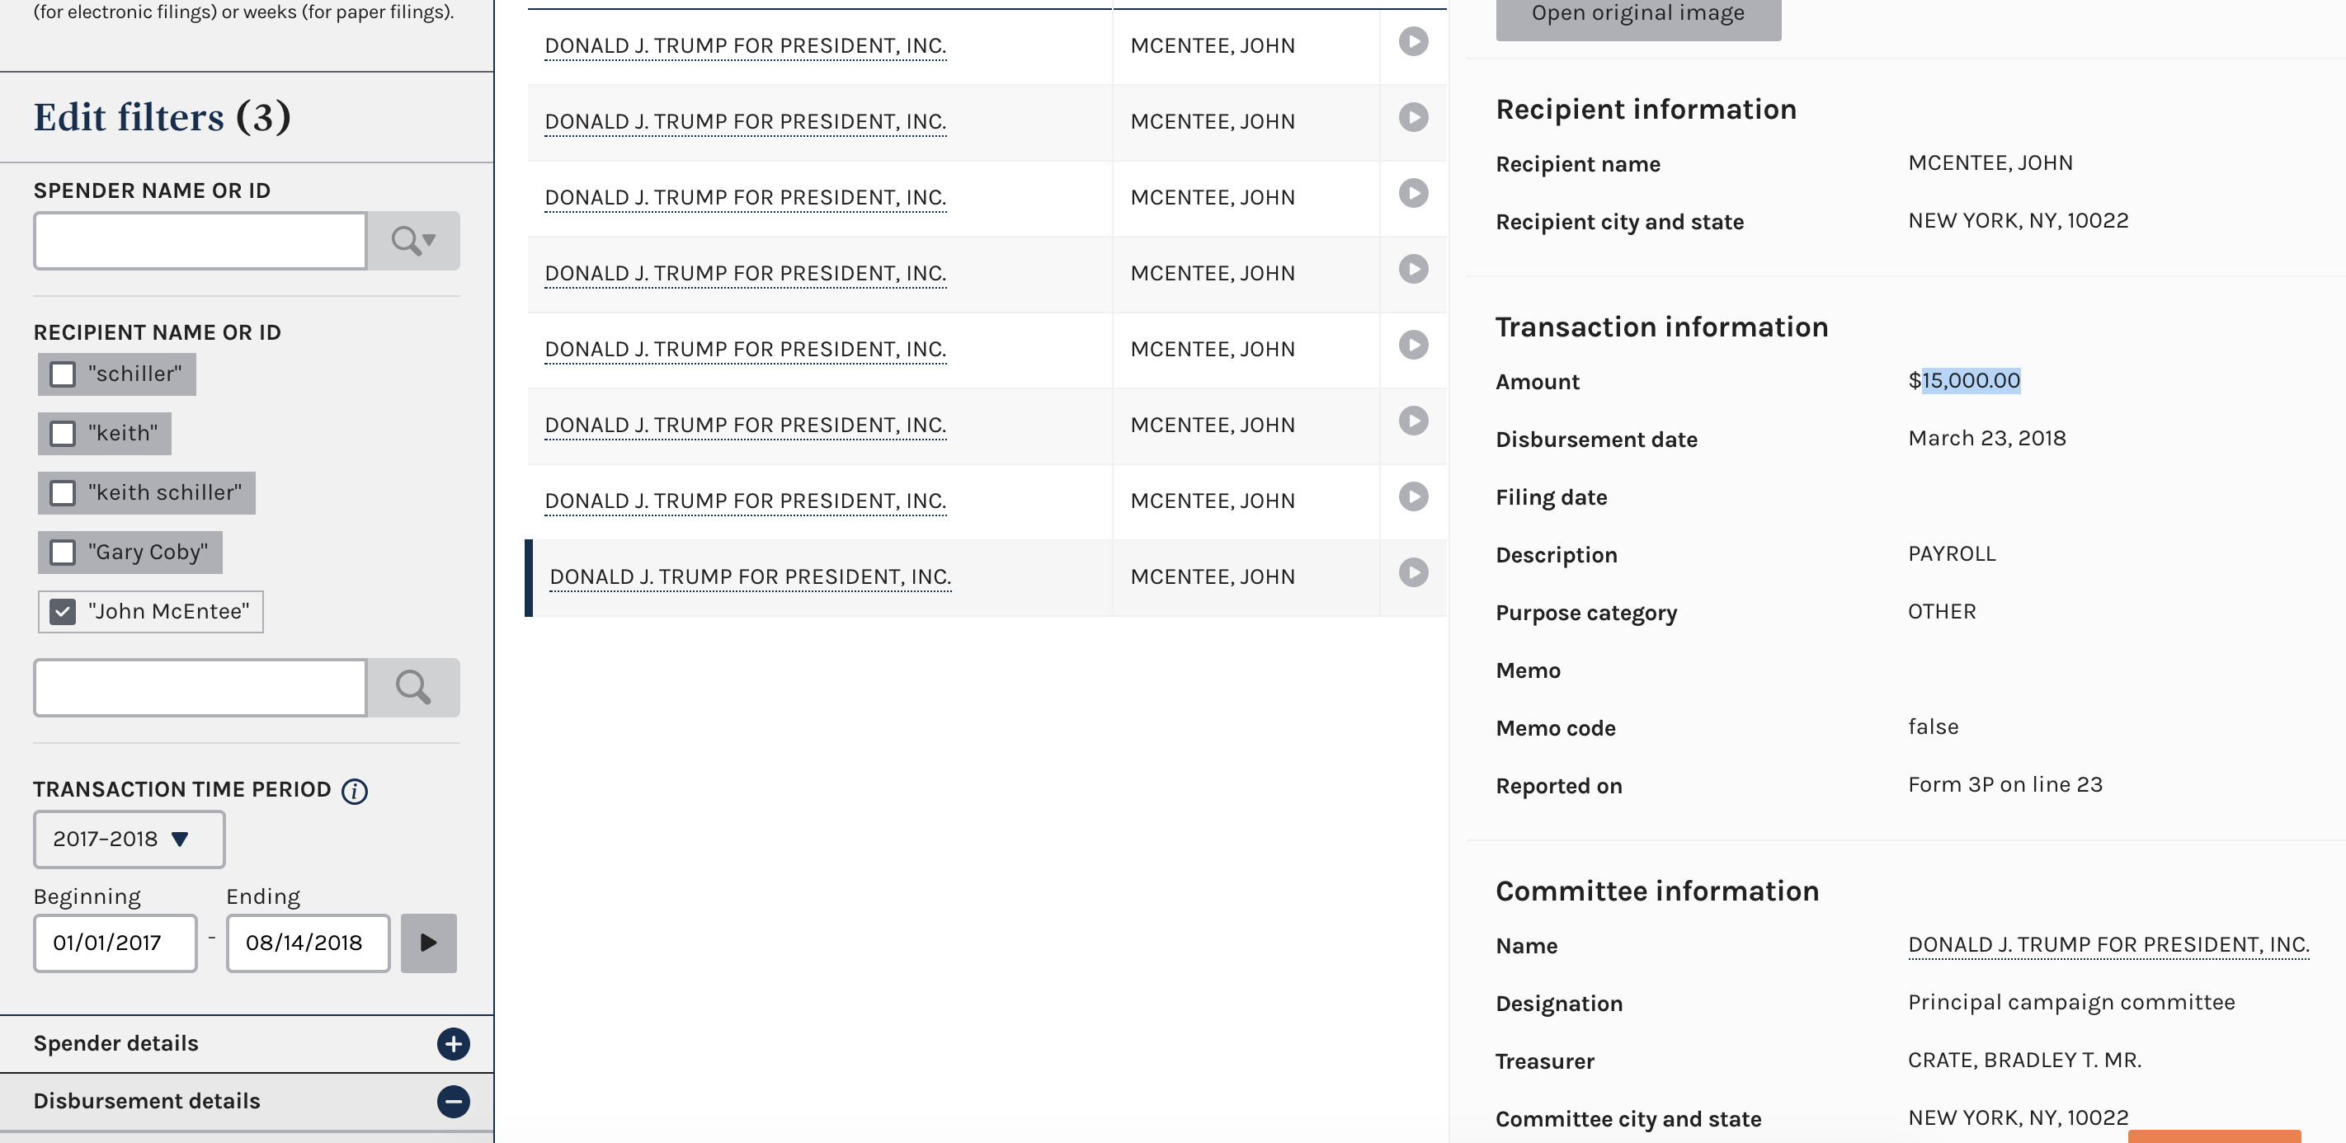
Campaign Finance and (Alleged) Crooks

Slide 10
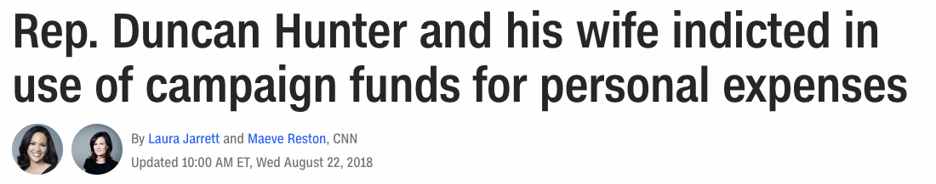
Campaign Finance and (Alleged) Crooks
And fresh off the presses!

Slide 11
Campaign Finance
Data we get:
All campaign contributions over $200 must be itemized and reported by the committee that receives them
All campaign expenditures must be itemized and reported by the committee
Filings are generally quarterly
Fec.gov/help-candidates-and-committees/dates-and-deadlines/

Slide 12
Campaign Finance
NYT’s Rachel Shorey: Three general types of camp fin stories:
Horserace stories: Which candidate is winning the money race?
Donor stories: Who is giving money (and why)?
Legal analysis stories: How are candidates working creatively inside (or outside) the law?

Slide 13
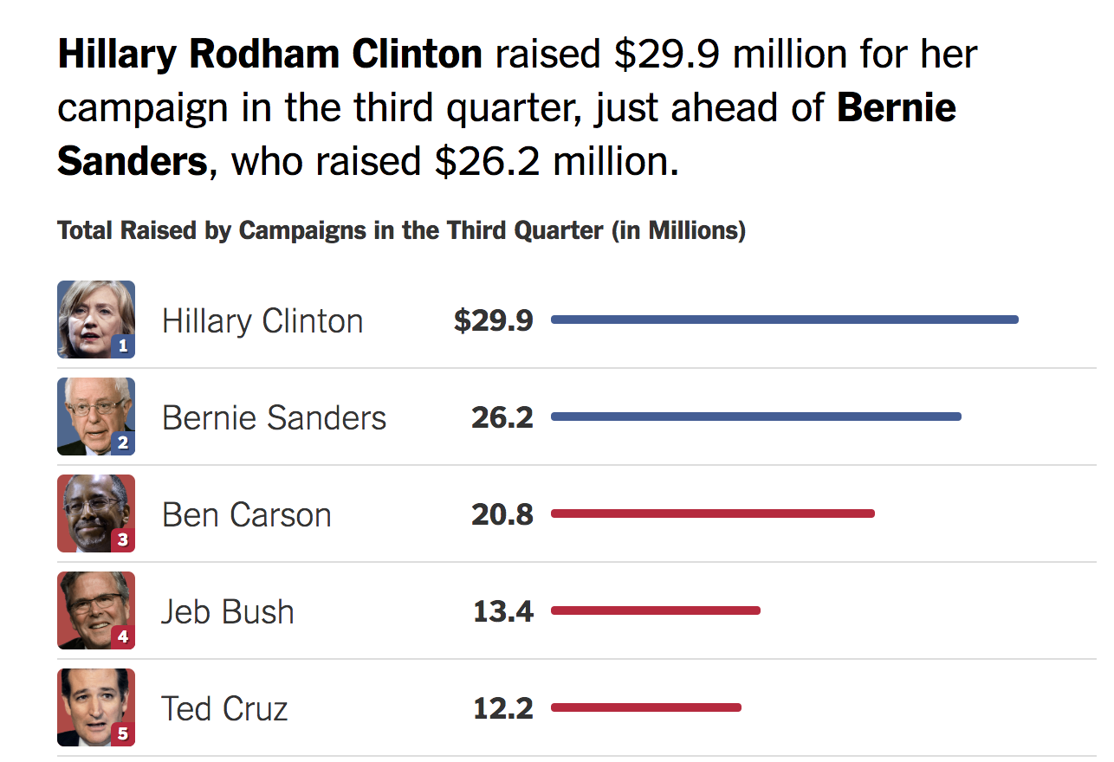
Campaign Finance - horserace

Slide 14
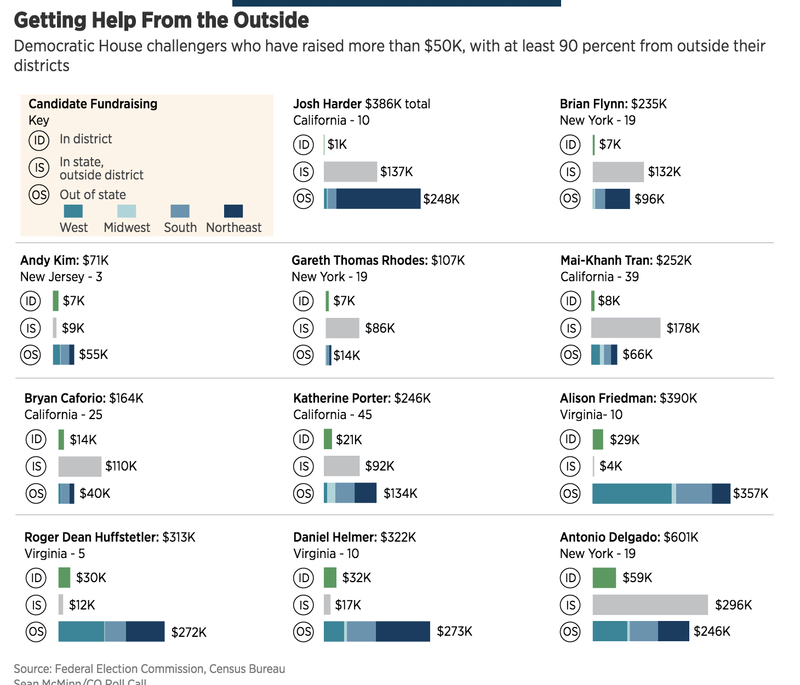
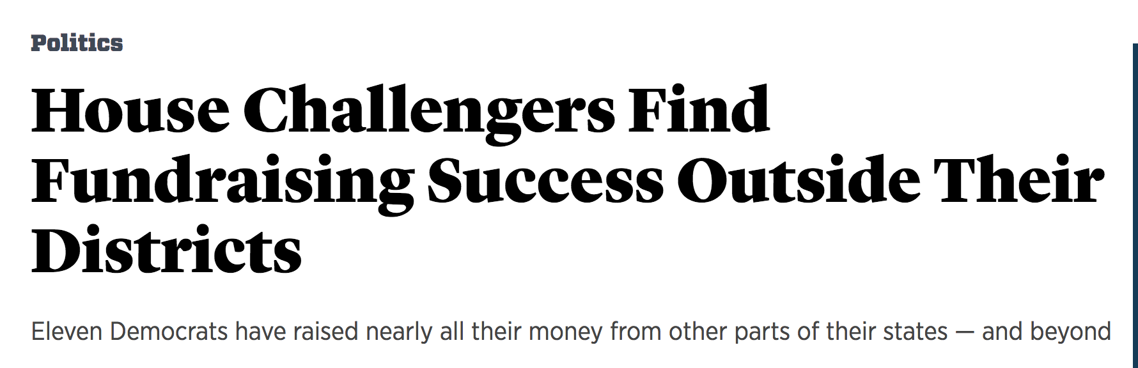
Campaign Finance - donors

Slide 15
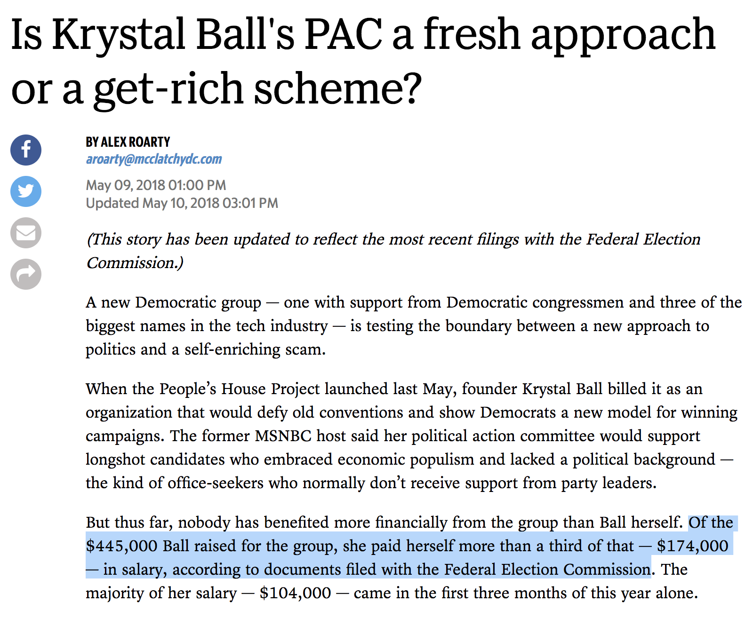
Campaign Finance - legality

Slide 16
Campaign Finance
To touch on PACs:
Anyone can set up their own committee to help a campaign
BUT there’s limitations on how much donors can give
The answer? Super PACs
Campaign committees vs PACs vs Super Pacs
Differences in how much people can give to them, and what they can spend on

Slide 17
Campaign Finance
How can reporters find these stories?
FEC.gov – your best friend for federal campaign finance
Everything from topline reports to individual expenditures and contributions
But first, a word …
Notes:
Look up: Spielberg, Northwestern president, Trump Northwestern donations, Clinton Northwestern donations

Slide 18

Campaign Finance
Pitfalls
Amendments
Refunds
$200 caveat – small vs big donors
Generally good to check your analysis by someone who’s done this before

Slide 19
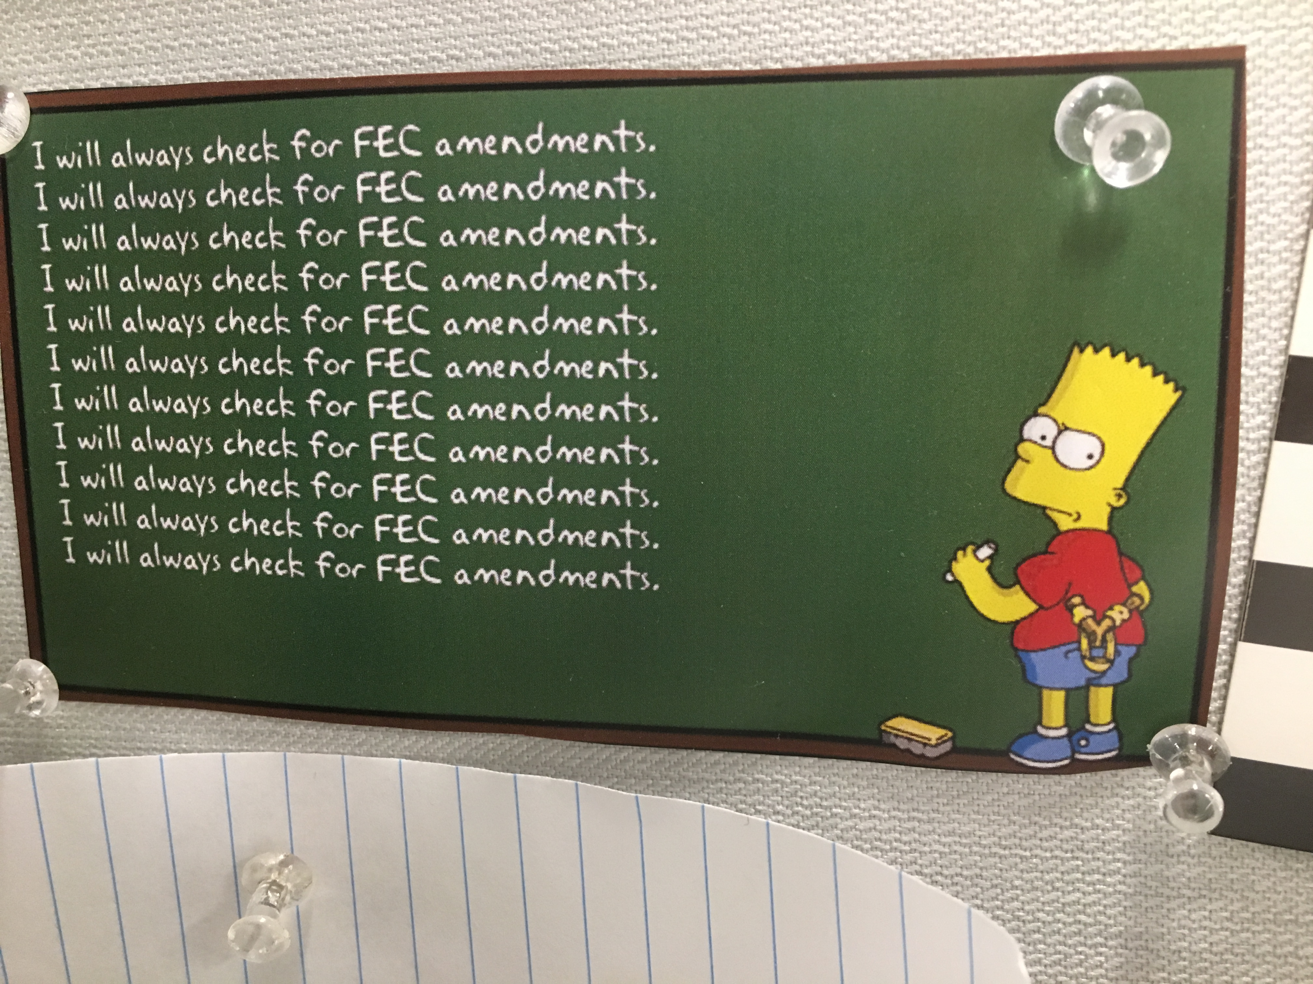
Campaign Finance

Slide 20
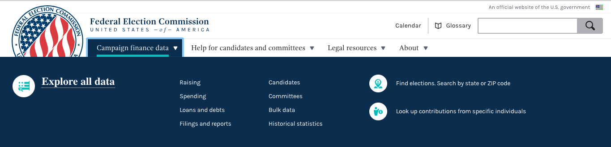
FEC.gov

Slide 21
Campaign Finance
Most useful pages on FEC website
Report summaries
Itemized contributions
Itemized disbursements
Notes:
Look up: Cruz v O’Rourke totals
itemized contributions search for george soros
Trump spending at Amazon

Slide 22
Other Camp Fin Resources
Open Secrets (CRP) (categorized and tagged data by industry, etc)
Opensecrets.org
Propublica FEC Itemizer (easy to search)https://projects.propublica.org/itemizer/

Slide 23
Lobbyists & Political Money
FEC bundlers
https://www.fec.gov/data/filings/?data_type=processed&form_type=F3L (This is the new FEC link for bundlers.)
Old FEC link: https://classic.fec.gov/data/LobbyistBundle.do?format=html
House disclosure database with link to LD-203 reports:
http://disclosures.house.gov/
Senate link to LD-203 reports:
https://soprweb.senate.gov/index.cfm?event=lobbyistselectfields

